Slide 1
2.2
Applications of Proportions
Warm Up
Lesson Presentation
Lesson Quiz
Holt Algebra 1
Holt McDougal Algebra 1

Slide 2
2.2
Similar figures have exactly the same shape but not necessarily the same size.
Corresponding sides of two figures are in the same relative position, and corresponding angles are in the same relative position. Two figures are similar if and only if the lengths of corresponding sides are proportional and all pairs of corresponding angles have equal measures.

Slide 3
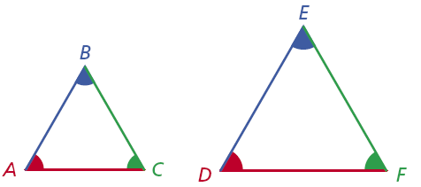
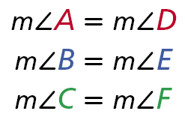
2.2
When stating that two figures are similar, use the symbol ~. For the triangles above, you can write ∆ABC ~ ∆DEF. Make sure corresponding vertices are in the same order. It would be incorrect to write ∆ABC ~ ∆EFD.
You can use proportions to find missing lengths in similar figures.

Slide 4
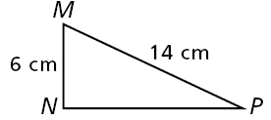
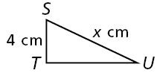
2.2
Example 1A: Finding Missing Measures in Similar Figures
Find the value of x the diagram.
∆MNP ~ ∆STU
M corresponds to S, N corresponds to T, and P corresponds to U.
6x = 56
Use cross products.
Since x is multiplied by 6, divide both sides by 6 to undo the multiplication.
The length of SU is cm.

Slide 5
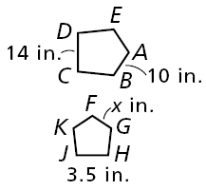
2.2
Example 1B: Finding Missing Measures in Similar Figures
Find the value of x the diagram.
ABCDE ~ FGHJK
14x = 35
Use cross products.
Since x is multiplied by 14, divide both sides by 14 to undo the multiplication.
x = 2.5
The length of FG is 2.5 in.

Slide 6
2.2
Reading Math
AB means segment AB. AB means the length of AB.
∠A means angle A. m∠A the measure of angle A.

Slide 7
2.2
You can solve a proportion involving similar triangles to find a length that is not easily measured. This method of measurement is called indirect measurement. If two objects form right angles with the ground, you can apply indirect measurement using their shadows.

Slide 8
2.2
Example 2: Measurement Application
A flagpole casts a shadow that is 75 ft long at the same time a 6-foot-tall man casts a shadow that is 9 ft long. Write and solve a proportion to find the height of the flag pole.
Since h is multiplied by 9, divide both sides by 9 to undo the multiplication.
The flagpole is 50 feet tall.

Slide 9
2.2
If every dimension of a figure is multiplied by the same number, the result is a similar figure. The multiplier is called a scale factor.

Slide 10
2.2
Example 3: Changing Dimensions
The radius of a circle with radius 8 in. is multiplied by 1.75 to get a circle with radius 14 in. How is the ratio of the circumferences related to the ratio of the radii? How is the ratio of the areas related to the ratio of the radii?
Circle A
Circle B
Radii:
Circumference:
Area:
The ratio of the areas is the square of the ratio of the radii.
The ratio of the circumference is equal to the ratio of the radii.

Slide 11
2.2
Example 4: Changing Dimensions
Every dimension of a rectangular prism with length 12 cm, width 3 cm, and height 9 cm is multiplied by to get a similar rectangular prism. How is the ratio of the volumes related to the ratio of the corresponding dimensions?
Prism A
Prism B
V = lwh
(12)(3)(9) = 324
(4)(1)(3) = 12
The ratio of the volumes is the cube of the ratio of the corresponding dimensions.

Slide 12
2.2
Helpful Hint
A scale factor between 0 and 1 reduces a figure. A scale factor greater than 1 enlarges it.

